Slide 1

Restaurant Recommendation

Slide 2
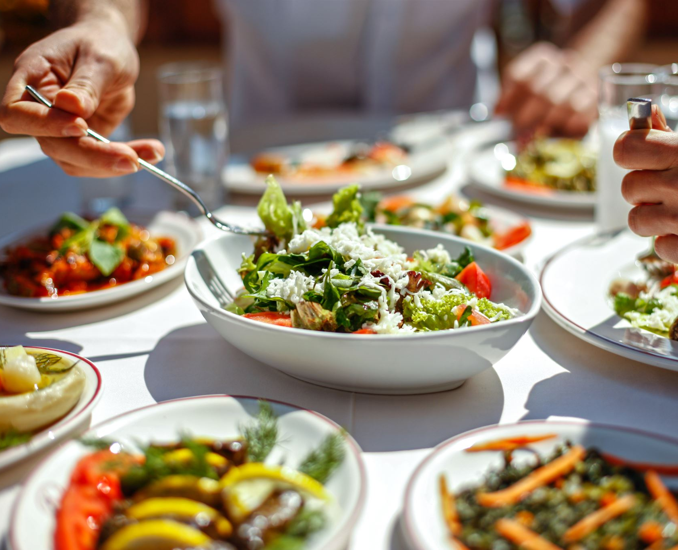
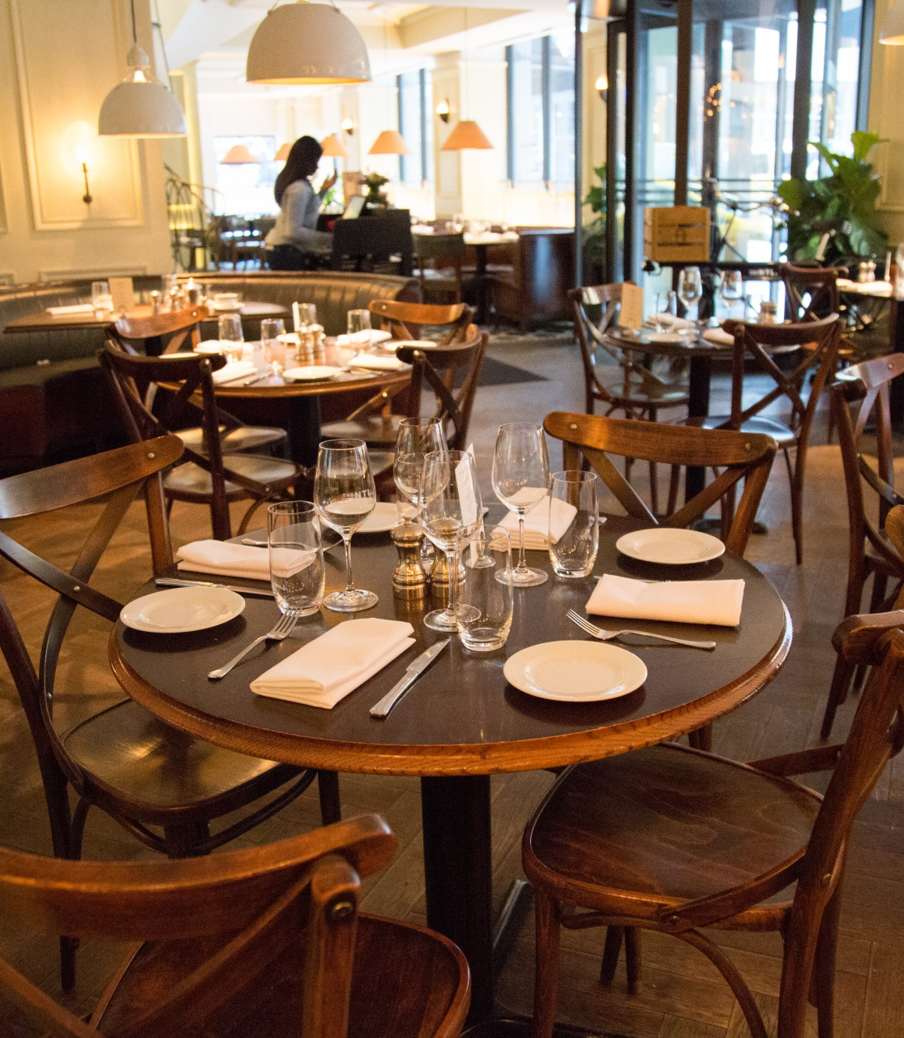
Team Members
B.Navadeep - 122010313051
B.Sharath - 122010314059
M.Tejas Manindra – 122010313034
G.Akhil - 122010319020

Slide 3

Why its needed?
As we all know that picking up a correct restaurant to chill with our families and friends is a very difficult task.
So we are here to help you with this task.
Our primary goal is to pick the correct restaurant based on attributes (online order, ratings, table booking, price for 2 and type of restaurant)
The required data set will be collected from some trusted sites like Kaggle.

Slide 4

Login and authentication page (if possible)
Here we will be having a sign-up page for new users
And a login page for already signed-up users.
This can be achieved using Django
Django is a high-level Python web framework that encourages rapid development and clean design.
It’s free and open source.

Slide 5

Skills required to complete this project:
Python
Html
CSS
Javascript

Slide 6


Hardware and software requirements:
Software: Ide such as vs code
Hardware: Pc or desktop with windows 7 or higher.

Slide 7
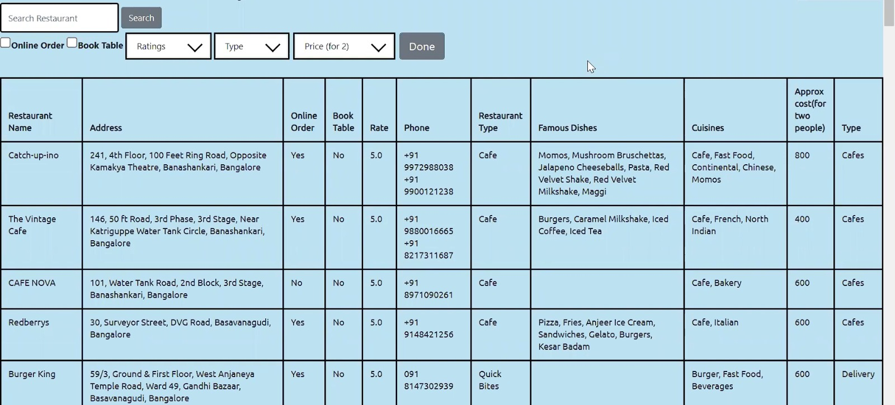
Example photos to show how our project looks

Slide 8

THANK YOU

